Slide 1
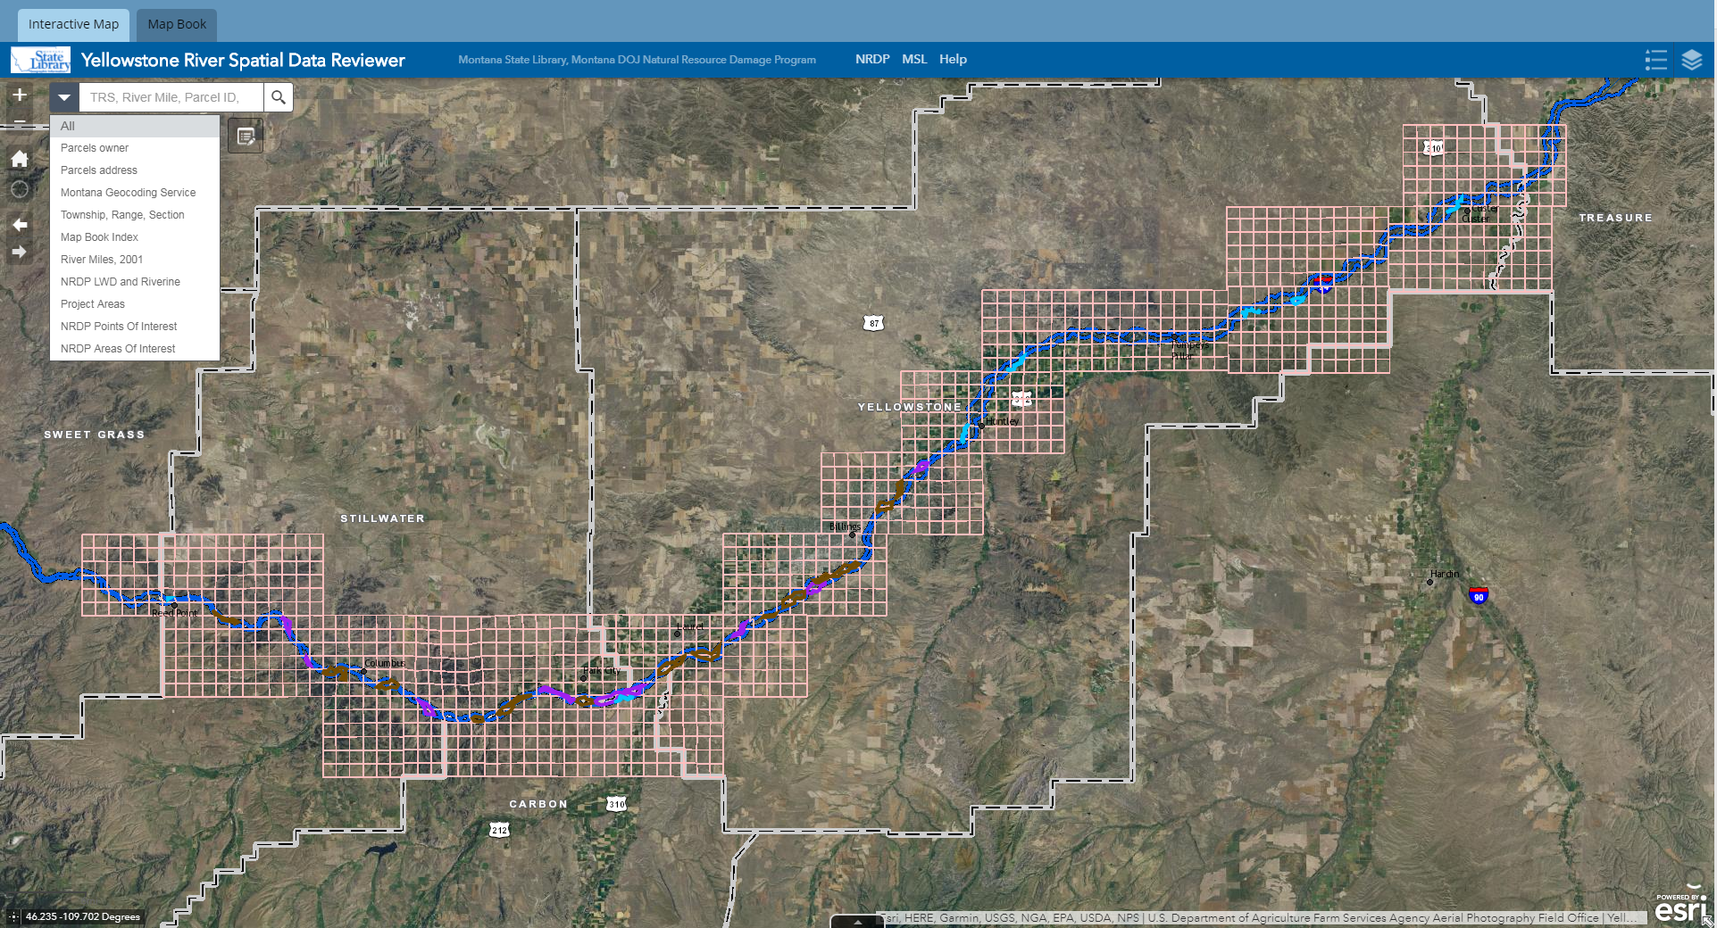
Click to draw point or area of interest
Hyperlinks to NRDP, MSL, Map Book, and help documents
Legend and Layers
Search by township, range, and section, river mile, parcel ID, address, lat/long coordinates, project area, or area of interest
Type in search box and then select from options. Do not press Enter or the search icon.
Lat/long coordinates. Click cross icon to set coordinates in one position.

Slide 2
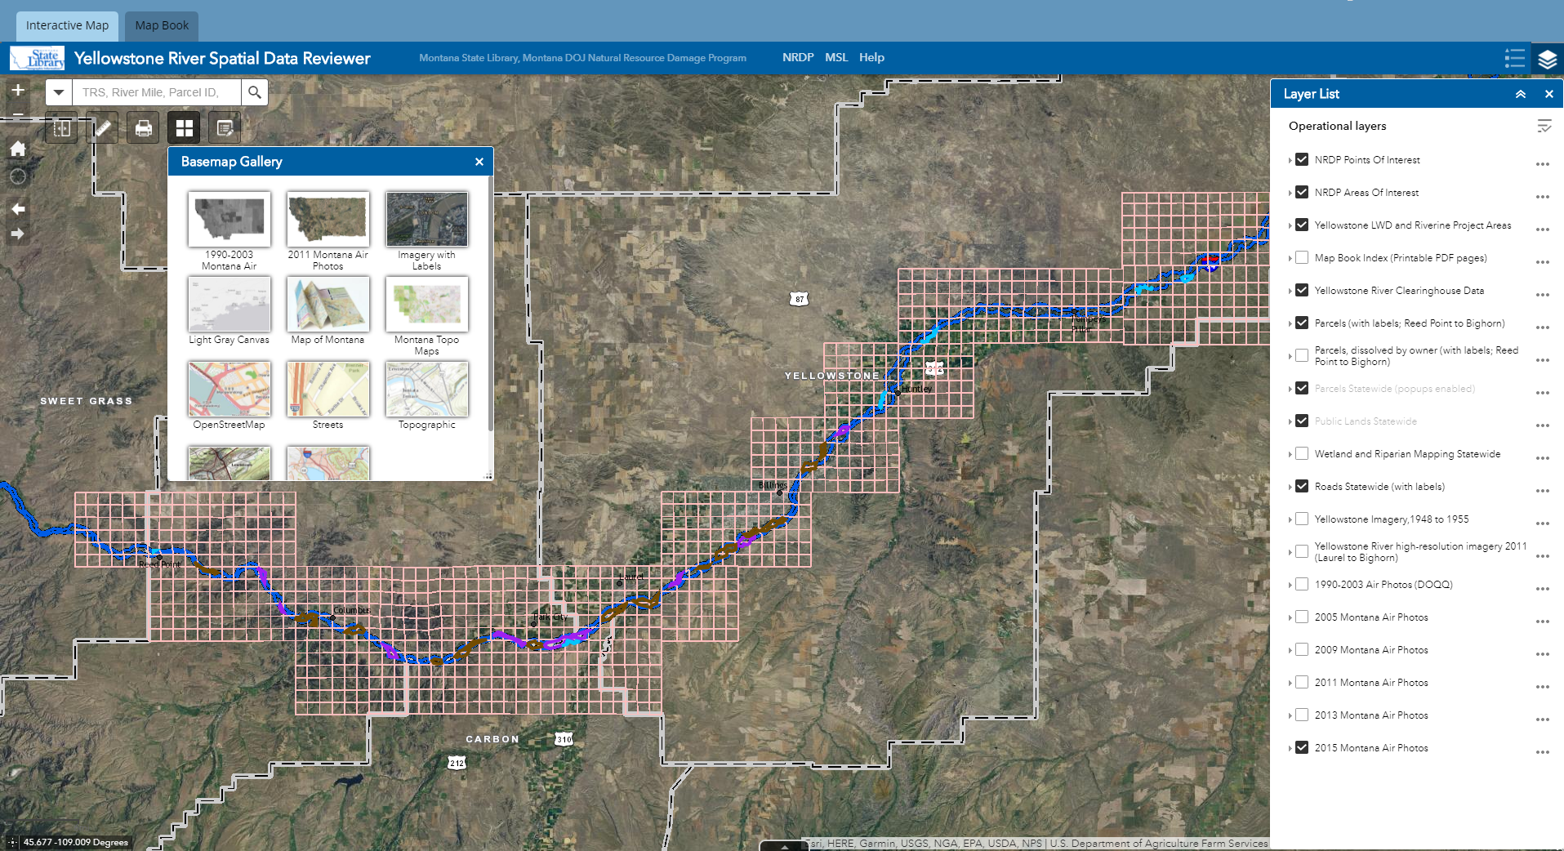
Click to open basemap gallery to choose a different basemap
Layer List. Click layers on and off.
Click on two different imagery layers to use with the swipe tool. Then click on the swipe tool and choose one of these layers from the dropdown menu.

Slide 3
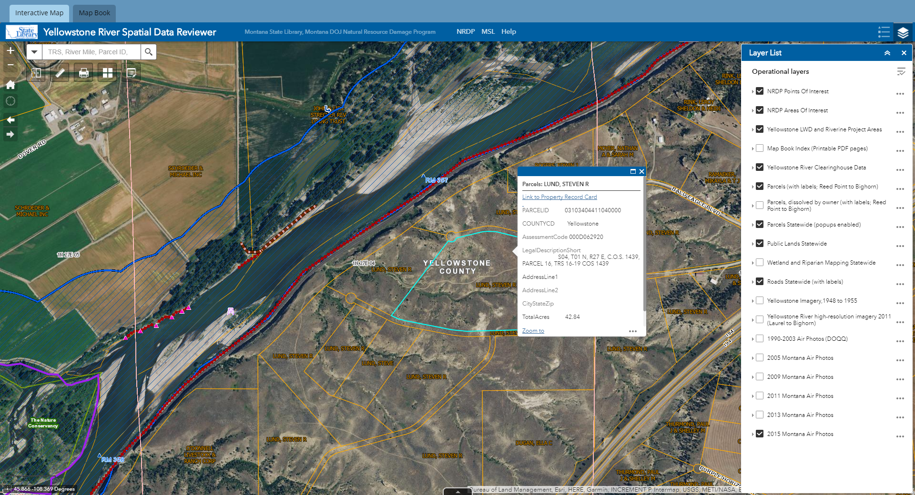
Click to turn on Parcels dissolved by owner name. If two adjacent parcels have the same owner, this layer shows them dissolved together. Undissolved parcels are shown by default.
Parcels statewide should remain checked at all times in order to access property card information via the popups.

Slide 4
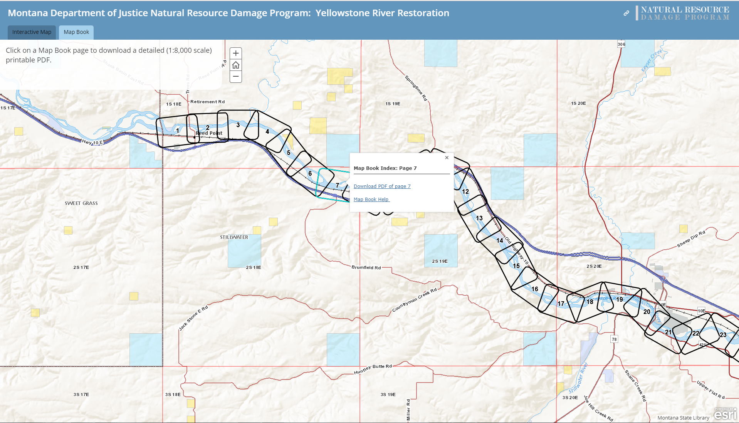
Click on the Map Book tab to access the Map Book Index.
Navigate to a location on the river and click on a page number to download an individual Map Book page and find the Map Book instructions.

