Slide 1
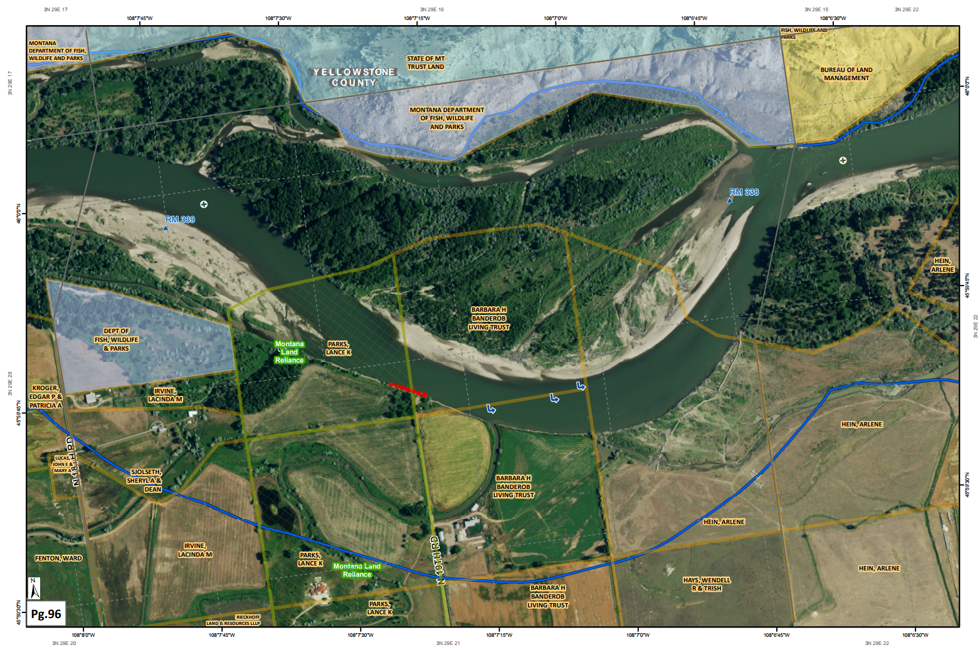
Yellowstone River Map Book:
Detailed (1:8,000 scale) maps of the Yellowstone River corridor from Reed Point to Bighorn, MT
Produced by the Montana State Library
for the
Department of Justice Natural Resource Damage Program
December 2017

Slide 2
Purpose: This Map Book was developed to aid decision makers in targeting areas for restoration along the Yellowstone River Corridor
Disclaimer: The Montana State Library provides this product/service for informational purposes only. The Library did not produce it for, nor is it suitable for legal, engineering, or surveying purposes. Consumers of this information should review or consult the primary data and information sources to ascertain the viability of the information for their purposes. The Library provides these data in good faith but does not represent or warrant its accuracy, adequacy, or completeness. In no event shall the Library be liable for any incorrect results or analysis; any direct, indirect, special, or consequential damages to any party; or any lost profits arising out of or in connection with the use or the inability to use the data or the services provided. The Library makes these data and services available as a convenience to the public, and for no other purpose. The Library reserves the right to change or revise published data and/or services at any time.

Slide 3
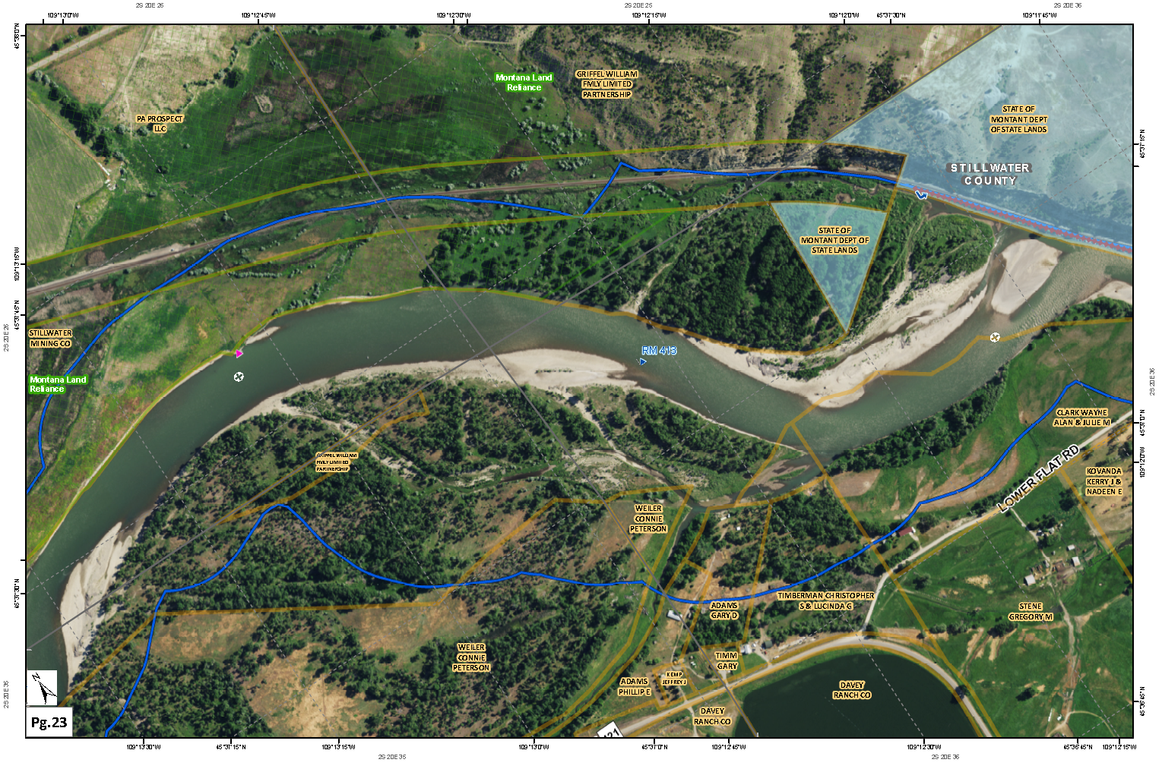
Map Book pages print best landscape at 11x17.
Conservation Easements are a green hatch and green label
Public Lands are a solid fill color with transparency
The scale is the same on all pages, 1:8,000 (4 inches = approximately ½ mile).
Channel Migration Zone
(solid blue line)
Locational information is around the outside of the map:
Latitude Longitude
(thin dashed gray line)
Township Range Section
(solid gray line)
Various point symbols represent physical features, such as, flow deflectors, headgates and irrigation infrastructure
River miles
(blue triangle with blue label)
Use the crosshair to align the adjacent page of printed maps
Use the crosshair to align the adjacent page of printed maps
Ownership parcel boundary
(solid orange line)
Ownership labels are black text with light orange outline
North rotates with each page
Map Book page number

Slide 4
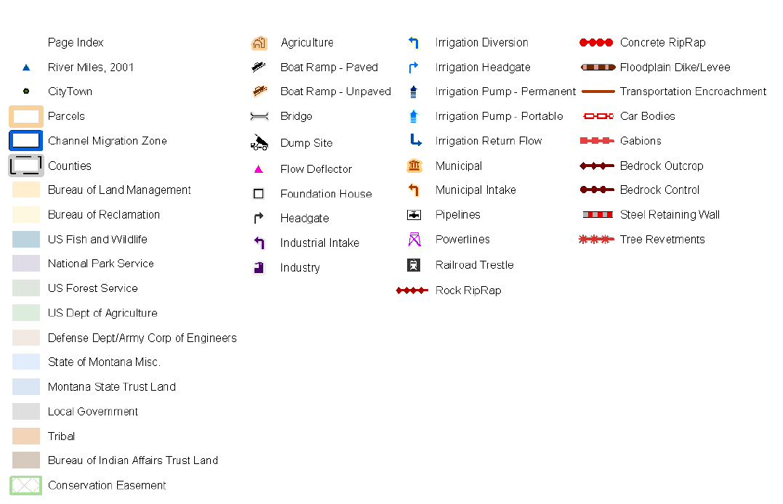
Legend

Slide 5
Map Index: pages 1-38
Downriver

Slide 6
Map Index: pages 39-70
Downriver

Slide 7
Map Index: pages 71-106
Downriver

Slide 8
Map Index: pages 107-135
Downriver

