Slide 1
NHD Revisions Best Practices
InterMountain GIS 2014
NHD Workshop
April 7, 2014

Slide 2
NHD User Guide
http://nhd.usgs.gov/userguide.html
Notes:
The NHD User Guide is the best source for information regarding definitions of FTypes and FCodes, and it also contains interactive tutorials and instructional videos.

Slide 3
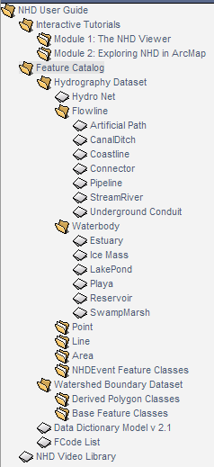
Example: StreamRiver
Notes:
The Feature Catalog contains cartographic and photographic illustrations of each FType, the associated FCodes, and a Feature Template that describes capture conditions.

Slide 4
Feature Template
Notes:
If you have questions regarding capture conditions, definitions of Ftypes and Fcodes, and attributes associated with some NHD features, the User Guide is the most authoritative source.

Slide 5
Editing Best Practices
Digitization scale: 1:5,000 or 1:8,000
Use snapping
Use multiple ancillary data layers to inform decisions:
National Wetlands Inventory
USGSTopo
Multiple aerial imagery years, both Normal Color and Color-Infrared (CIR)

Slide 6
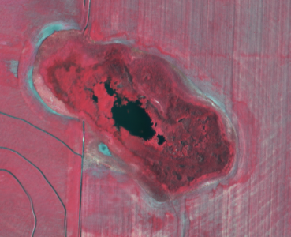
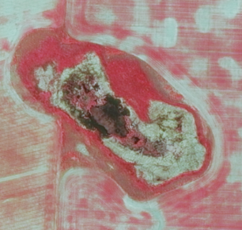
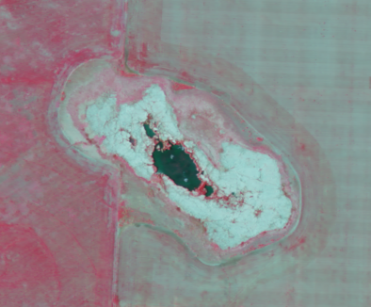
Average Conditions
NAIP 2005 CIR
NAIP 2011 CIR
NAIP 2009 CIR
Notes:
Either digitize according to average conditions gleaned over several years’ imagery or digitize to a specific year and make sure it’s documented. You can also consider using the capture conditions from the User Guide’s Feature Catalog as documentation for how you are choosing to digitize.

Slide 7
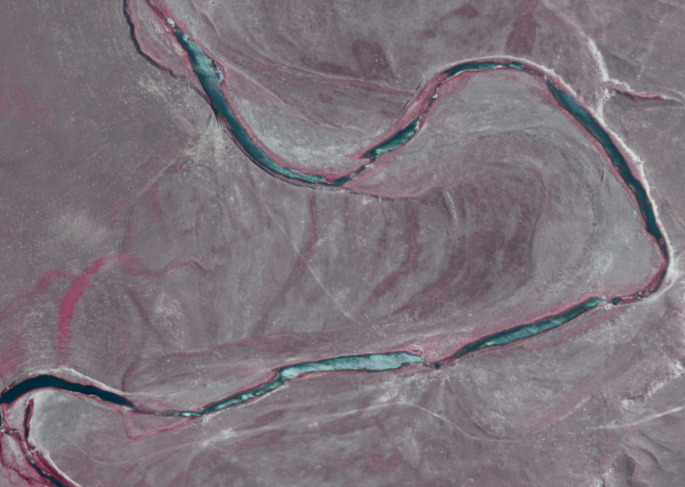
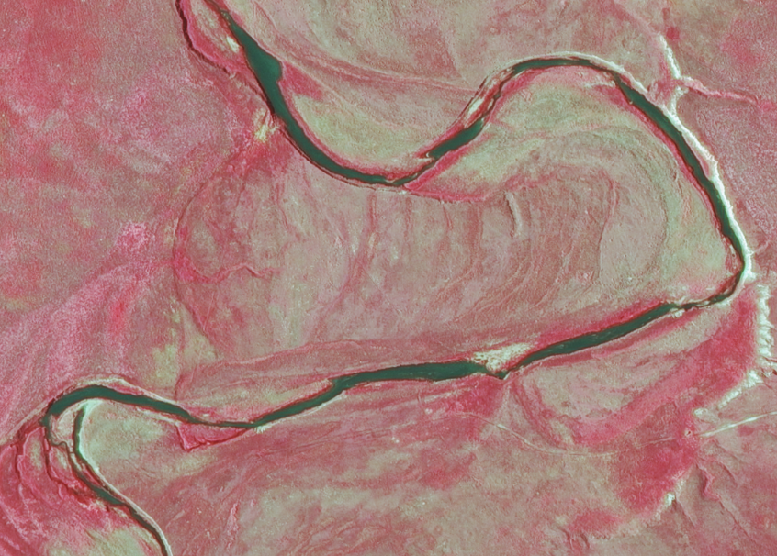
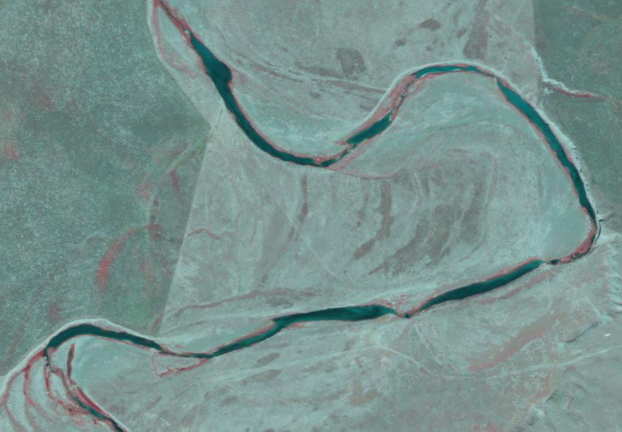
NAIP 2005 CIR
NAIP 2011 CIR
NAIP 2009 CIR

Slide 8
Metadata
Document editing processes and standards in the metadata:
Digitization scale
Imagery year digitized to, if specific
Ancillary layers used

