Slide 1

Introduction to the National Hydrography Dataset
InterMountain GIS 2014
NHD Workshop
April 7, 2014
Many slides and figures in this presentation were adapted from the USGS presentation, “Overview of the National Hydrography Dataset” by Jeff Simley. The USGS and Montana State Library are partners in maintaining the Hydrography Dataset in Montana.

Slide 2
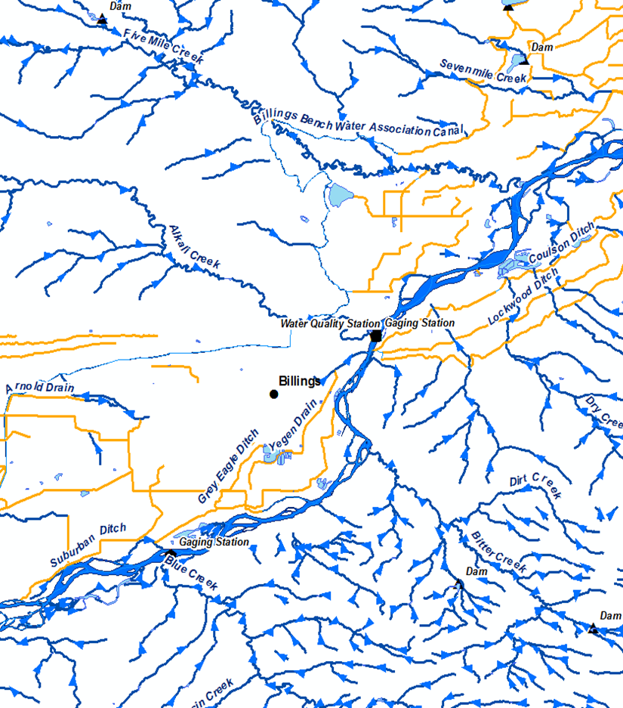

What is the National Hydrography Dataset?
A comprehensive set of digital spatial data representing the nation’s surface water features:
  Lakes/ponds (200K +)
  Rivers/streams (170K+ mi)
  Springs (10,661)
  Waterfalls (364)
  Gauges (4956)
  WQ Stations (3190)
  Dams (3699)
  Wells (5835)
  And more! . . .
NHD high-resolution (24K)
Notes:
The NHD is a comprehensive set of digital spatial data representing the nation’s water features, including lakes, ponds, rivers, streams, springs, waterfalls, gauges, water quality stations, dams, wells, and much more.
The figure on this slide shows the NHD with Billings near the center. We can see tributary confluences with the Yellowstone River, and also, dams, ditches, and gauges. Additionally, the blue arrows (difficult to see) on the stream lines show direction of flow---the NHD organizes water features into a flow-directed network. This allows the user to identify upstream and downstream spatial relationships between hydro features. For example, a user could click on the confluence of Fivemiile Creek with the Yellowstone and discover all dams or gauges located upstream or downstream…or you could also trace between two points, such as all water quality stations between two confluences.
In addition to the points, lines, and polygons (or geometry) the NHD also carries valuable attributes, such as intermittent or perennial, names, descriptions, lengths, etc. The NHD is a comprehensive spatial database.

Slide 3
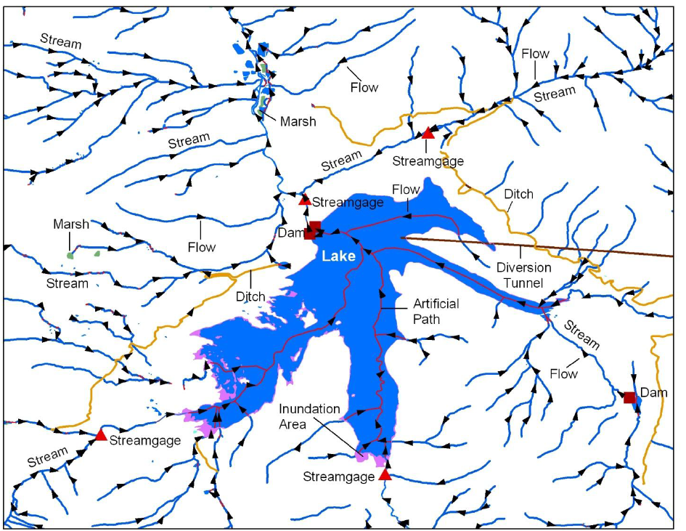
What is the National Hydrography Dataset?
Water data and information!
Notes:
The NHD is a comprehensive spatial database.

Slide 4
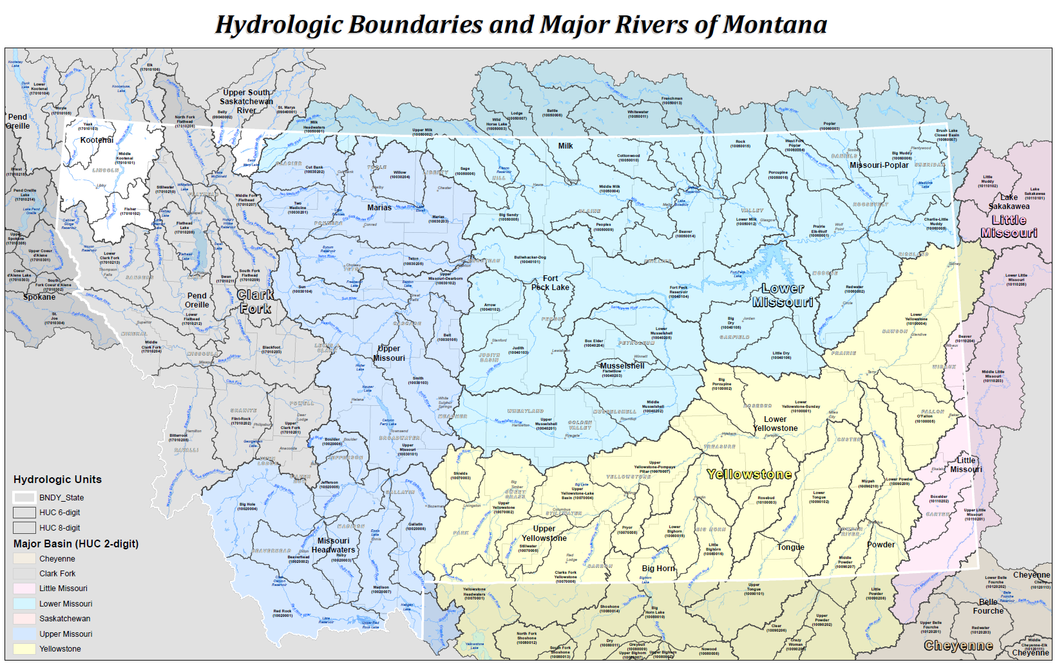
How are the data organized?
Notes:
Logically, data are organized into hydrologic units, or HUCs; Water data are organized by watershed or basin—physical rather than political.
Concept of nested management units.

Slide 5
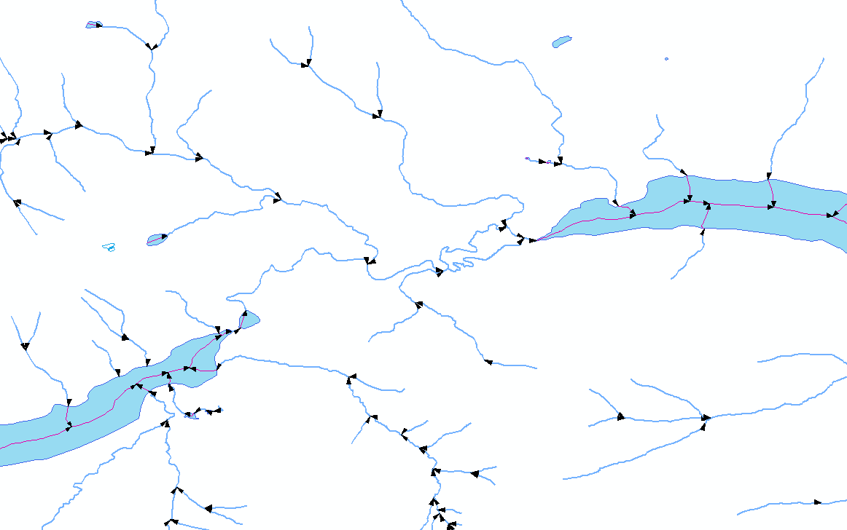
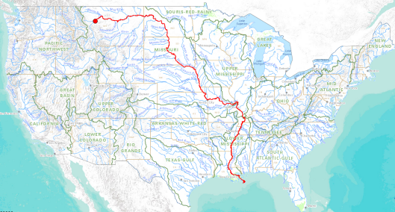
What does the NHD provide?
A flow directed network (upstream and downstream traces)
  Gives intelligence to the data

Slide 6
What does the NHD provide?
A nationally consistent addressing system for water data (linear referencing)
Gauge
(m = 50)
Reach
17010204000506
Reach
17010204000721
0
Subbasin/ Reach
17010204000505
Linear measures (m)
Much like addresses on a street
100
Notes:
The NHD is so powerful as an information system because it provides a nationally consistent basis for assigning addresses to water-related data, known as events. The NHD network is broken into segments or reaches, each assigned a unique id (reachcode). A reachcode consists of the 8-digit subbasin number (hydrologic basin), then the last 6 digits define the reach. Features, or events, are then located using measures along their respective reach. For example, the gauge in this illustration is located at the 50% measure of reach code 17010204000506
The intricate details of how this works isn’t important to most users…just know that the NHD provides and addressing system, much like addresses on a street.
A nationally consistent framework allows water-related information from one organization to be shared with others and more easily integrated into many different use cases and applications. Recalling the first slide, this is exactly what Montana’s WIS is all about: improving discovery and increasing sharing of water-related data

Slide 7
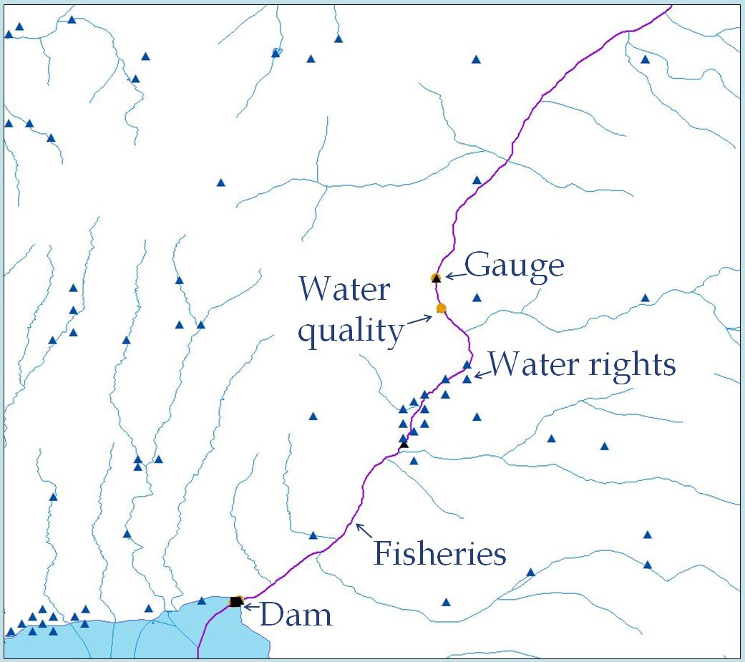
What does the NHD provide?
The NHD integrates data
Notes:
A nationally consistent framework allows water-related information from one organization to be shared with others and more easily integrated into many different use cases and applications: improving discovery and increasing sharing of water-related data…which is exactly what the State Water Information System is all about.

Slide 8
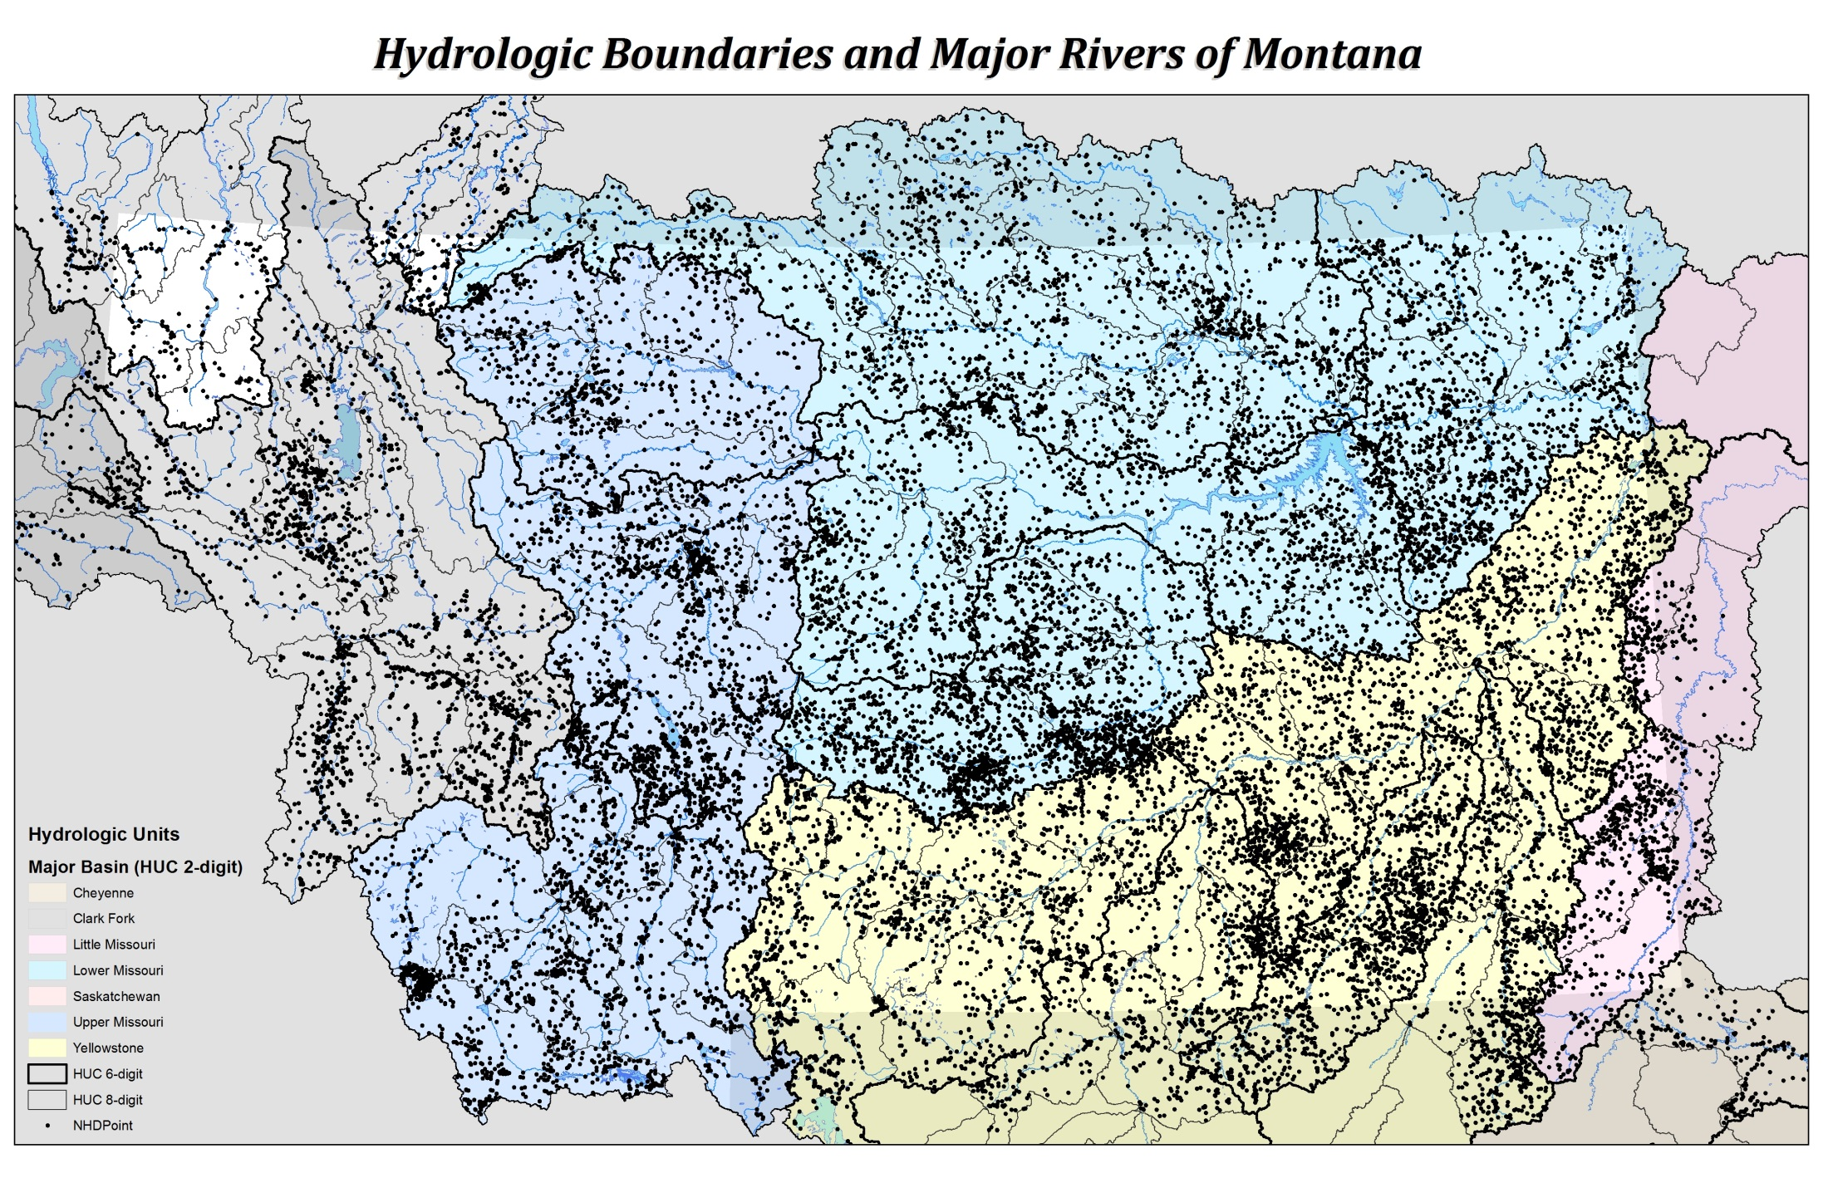
The NHD provides vast opportunity for discovery of water-related data
Notes:
There are already 1000s of features “addressed” to the National Hydrography Dataset. This map shows major hydrologic basins (the Yellowstone, Lower Missouri, upper Missouri, Clark Fork, then each one of the black dots represents a water-related feature tied to the NHD. So, the NHD isn’t just rivers and lakes…it’s also dams, ditches, gauges, springs, waterfalls, wells, pipelines, hazards zones, etc. Most of these data are federal, such as dams or USGS gages---What we are aiming to do with the WIS is bring in more State and local-level data.

Slide 9
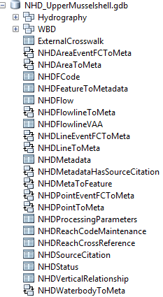
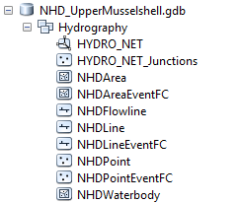
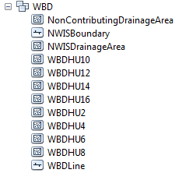
Geodatabase Structure

Slide 10
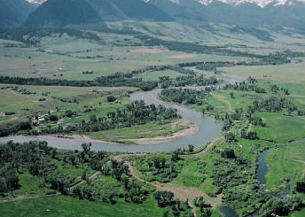
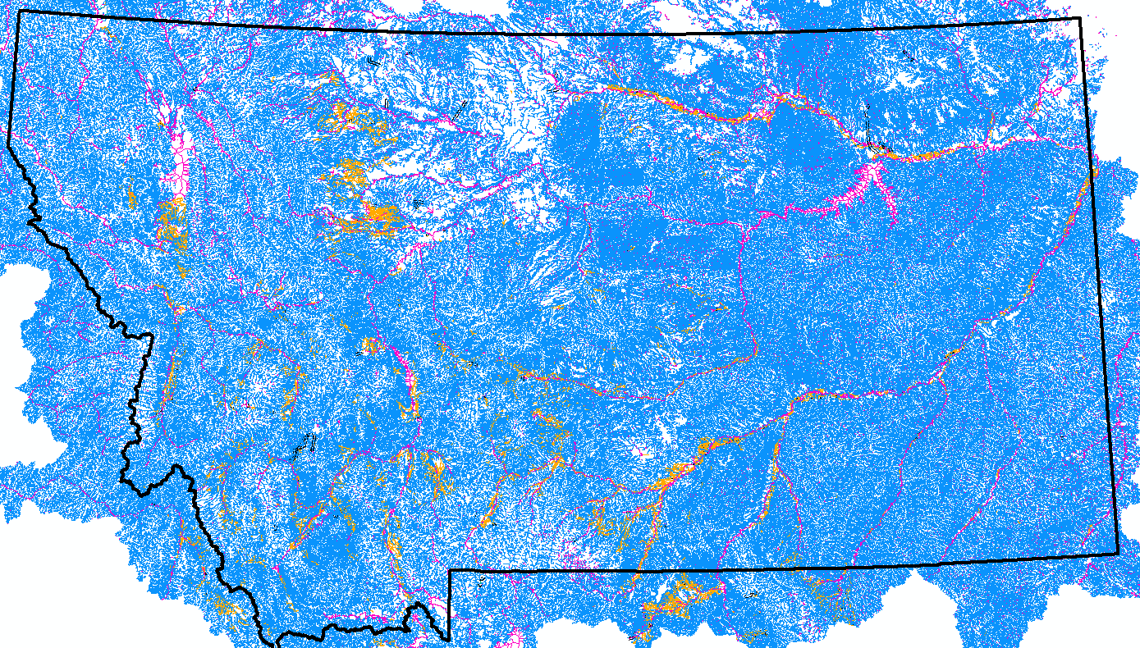
NHDFlowline
Lines for features that have flow
Streams and Rivers
Canals and Ditches
Pipeline
Artificial Path
Connector
Streams are the fundamental core of the NHD

Slide 11
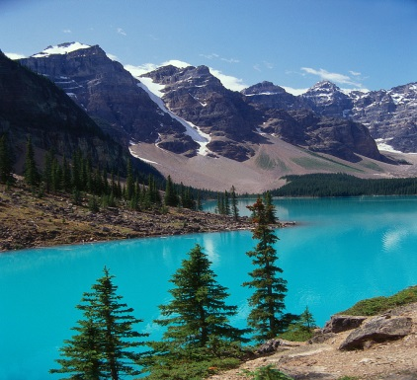
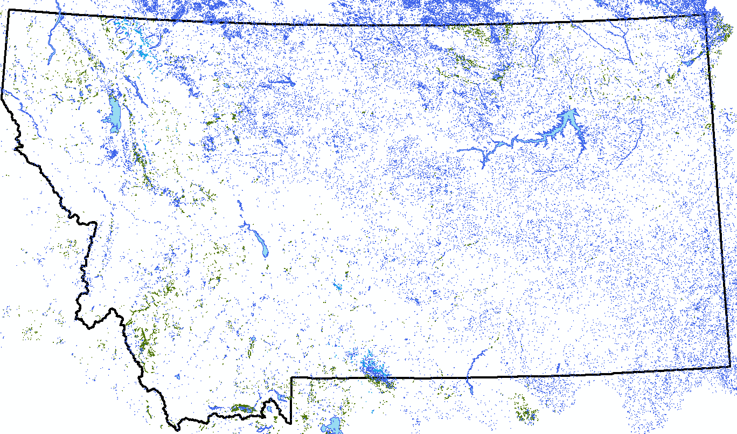
NHDWaterbody
Polygons of hydrographic features
Lakes and ponds
Reservoirs
Swamps and marshes
Ice mass (glaciers)

Slide 12
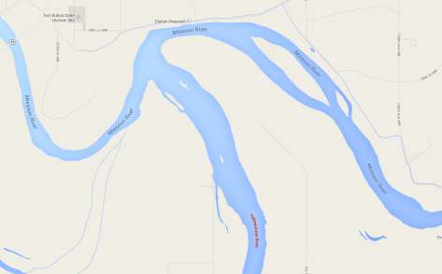
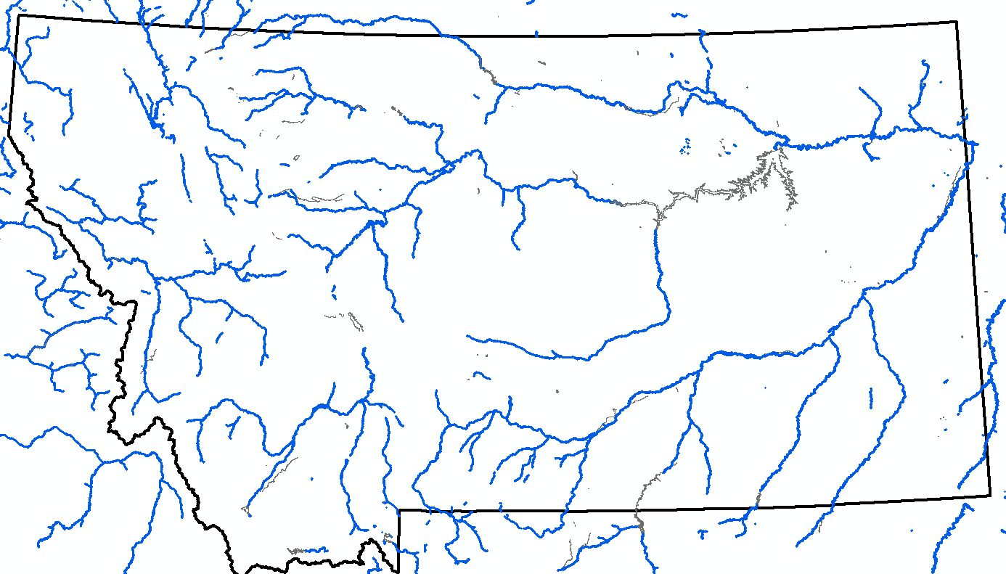
NHDArea
Polygons of areal (2D) hydrographic features
Large rivers and streams
Large canals
Inundation area
Hazard zones

Slide 13
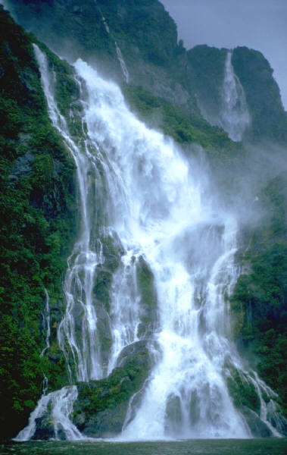
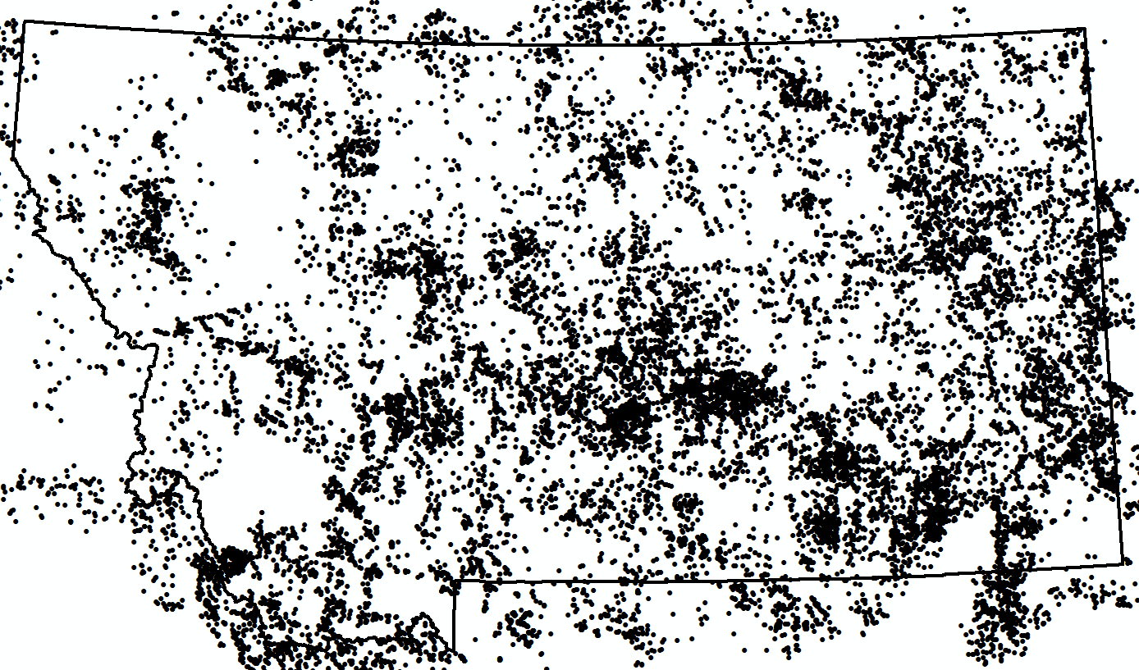
NHDPoint and NHD Line
Points or Lines representing hydro landmark features
Bridge
Rapid
Spring
Waterfall
…many more

Slide 14
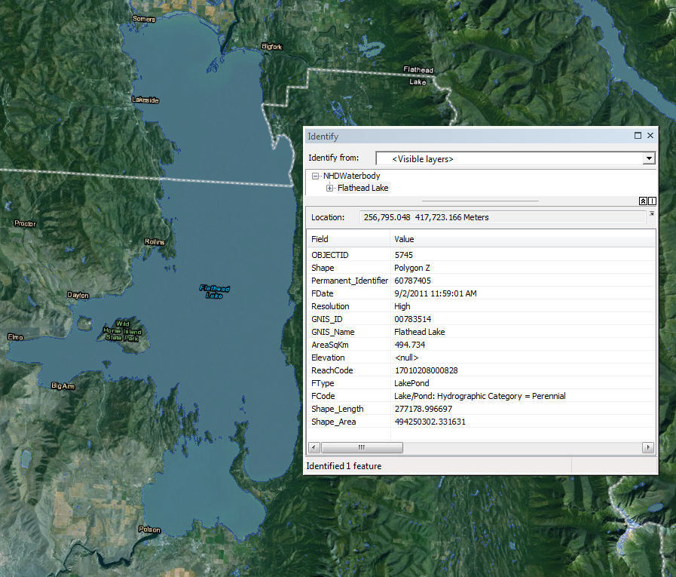
Attributes
Permanent_Identifier = Primary Key (unique)
Fdate =Date of last edit
FType = general category of a feature, such as LakePond
Fcode = description of a feature, such as perennial lake at normal pool
Reachcode = 14-digit unique identifier
GNIS_Name = official, proper name (accepted by BGN)

Slide 15

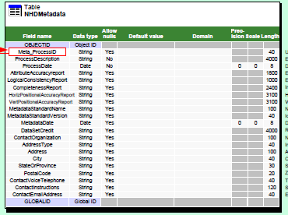
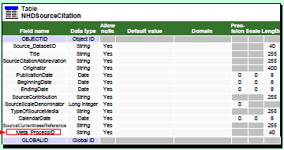
Metadata
Feature-level
    Who: Contact info for agency that last edited
    What: A description of the edit made and the source used
    When: date metadata was created and date of source used
For every single feature!

Slide 16
Take Home Messages
The NHD is a vast digital spatial database (GIS) representing the Nation’s surface water features
The NHD provides a flow-directed network
  The flow network is what gives NHD its analytic power
The NHD provides an addressing system for water-related data (linear referencing)
The NHD has feature-level metadata that describe the who what and when of every feature

Slide 17
USGS Video
USGS overview of the NHD (6:33)
  http://nhd.usgs.gov/nhd_video.html

