Slide 1
Hydrography Dataset Events
InterMountain GIS 2014
NHD Workshop
April 7, 2014

Slide 2
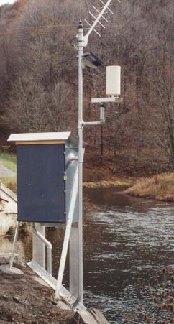
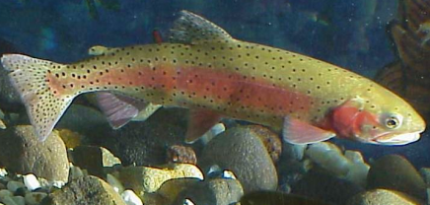
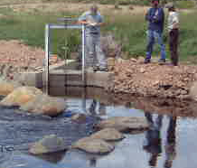
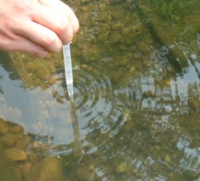
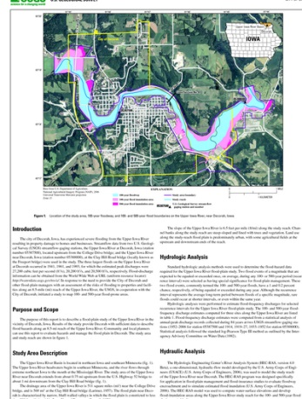
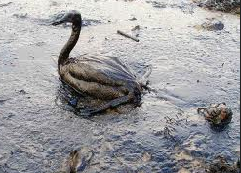
Examples of events
Essentially any water-related data that can be given a location:
Aquatic species habitat
Stream gage
Water quality station
Temperature measurement
Water rights
Recreation designations
Fish distribution
Wildlife sightings
Pollution control classifications
A study or news article
… many more

Slide 3
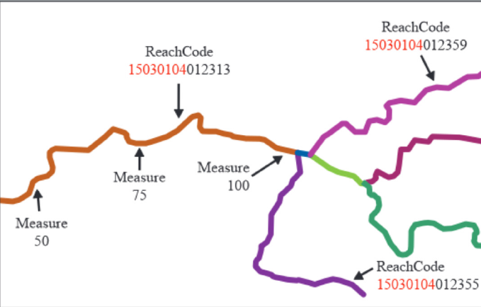
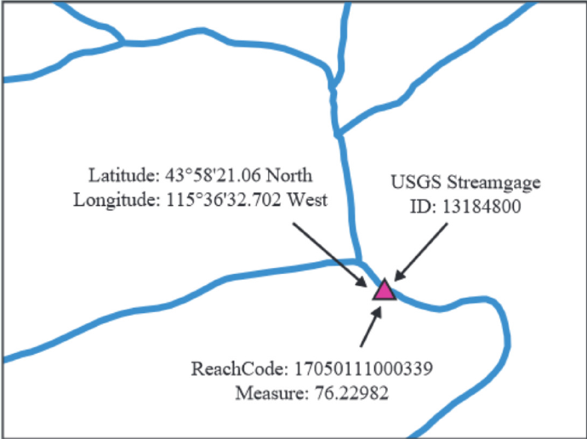
Reachcodes and measures provide an “address” for events
EVENT
Figure source: “USGS National Hydrography Dataset- Linear Referencing”, online PDF

Slide 4
Like a house address
ZIPCODE
STREET
House Number
Figure source: “USGS National Hydrography Dataset- Linear Referencing”, online PDF

Slide 5
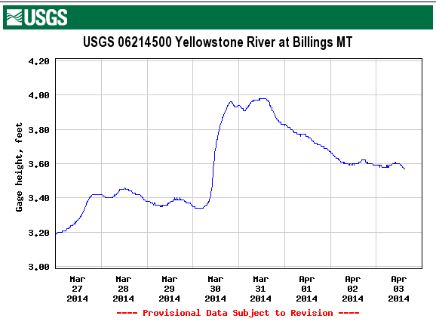
Events add intelligence to the Hydrography Dataset
Figure source: “USGS National Hydrography Dataset- Linear Referencing”, online PDF

Slide 6
Take Home Messages
The NHD provides a universal system for linking, or addressing, data (linear referencing)
Addressing water data (events) to the NHD integrates your data with other data, facilitates data discovery, and increases sharing opportunities
Linear referencing adds intelligence to your data (and, vice versa, your data add intelligence to the NHD)

Slide 7
USGS Video
Linear Referencing (4:21)
http://nhd.usgs.gov/videos_demos.html#.U07AuFcVAwA
HEM tools (3:43)
http://gallery.usgs.gov/videos/453#.UzXJRVemX5M

