Slide 1
NHD Products and Applications
InterMountain GIS 2014
NHD Workshop
April 7, 2014

Slide 2
USGS Featured Applications
http://nhd.usgs.gov/applications.html#
Notes:
The NHD can be used for a variety of applications, in large part because the user is able to build a geometric network from the flowlines that shows the flow of water throughout a subbasin.

Slide 3
StreamStats
Analyzes stream network upstream and downstream from a user-selected point (network tracing)
Digital stream network – connected set of points (junctions) and lines (edges) that supports tracing functions
http://streamstats.usgs.gov/index.html
Notes:
Points (known as point events) such as dams, streamgages, and diversions, are indexed to the stream network. Features attributed to lengths along a stream, such as an impaired reach, are represented as reach events. The primary benefit of the trace functionality is to understand how the flow at a particular site of interest may be affected by upstream features or how downstream flow may be affected by existing or proposed activities at the selected site.

Slide 4
StreamStats
Three data model components
Geographic (x,y,z)
Logical (point-line topology connections
Addressing (position m along the line)
http://daisy.ccny.cuny.edu/~michael/Courses/CE_G0800/Lecture_07_NetworkAnalysis.pdf

Slide 5
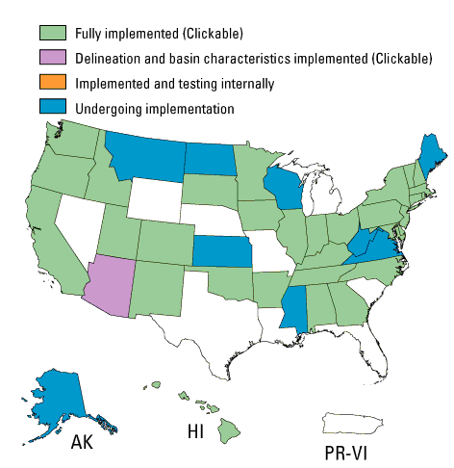
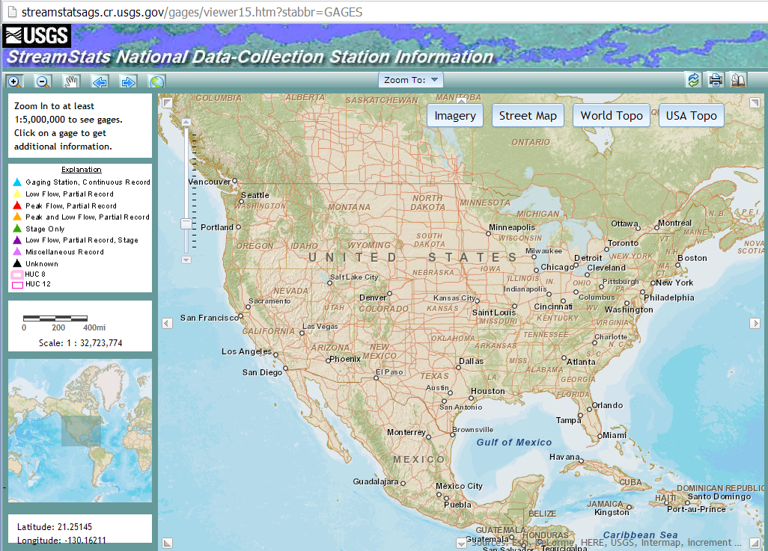
StreamStats by State
Notes:
Montana undergoing implementation. There is a separate application for Montana that allows users to obtain information for USGS data-collection stations.

Slide 6
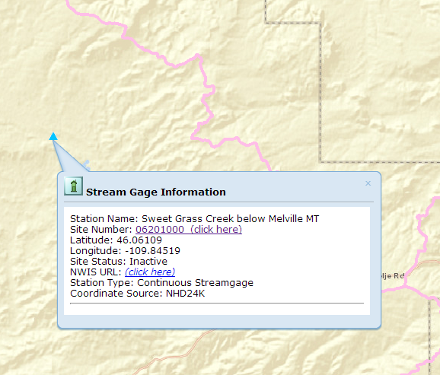
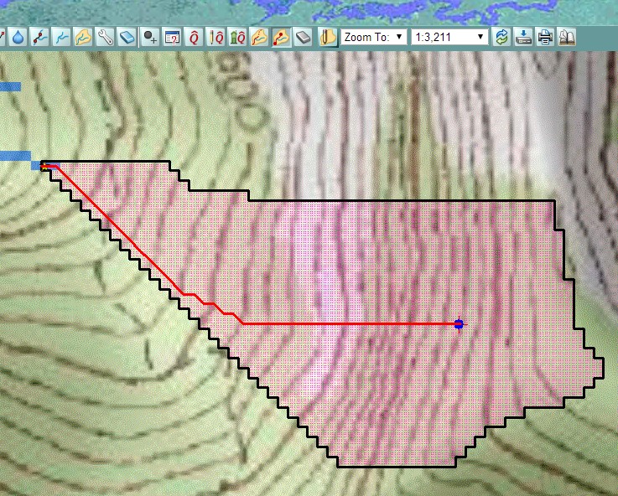
Network Navigation
Separate application
StreamStats application
Notes:
In Montana, using the separate application, the user can access statistical information for specific stream gages, but the application lacks the watershed delineation, network tracing, estimating flows using regression equations, etc., capabilities of the StreamStats application.

Slide 7
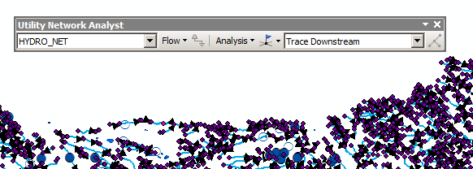
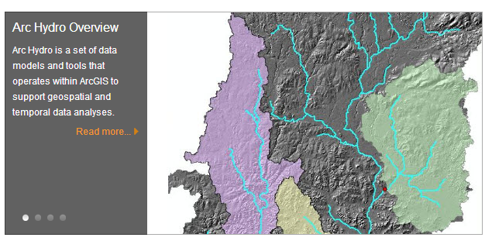
ArcGIS Desktop
Notes:
If StreamStats hasn’t been implemented in your state, you can use the Utility Network Analyst toolbar in ArcGIS Desktop to perform some of the same functions. This will also require you to download the NHD data first. ArcHydro tools are also available and have a lot of functionality associated with them.

Slide 8
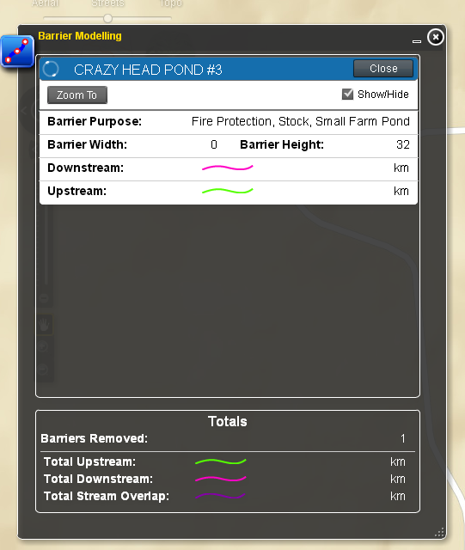
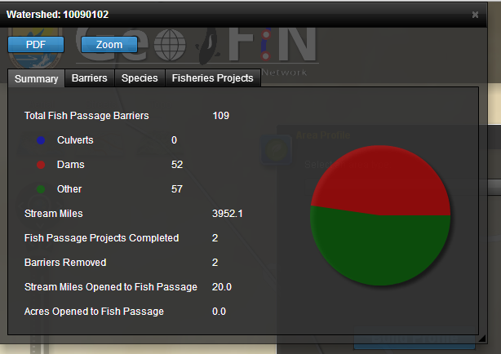
GeoFIN – Geospatial Fisheries Information Network
Managed by the USFWS Fisheries Program
Provides assistance to partners for removal or bypassing of fish barriers
http://ecos.fws.gov/geofin/
Notes:
This application uses information from the NHD to inform its functionality, such as stream miles, number of dams in a watershed, among other information.

Slide 9
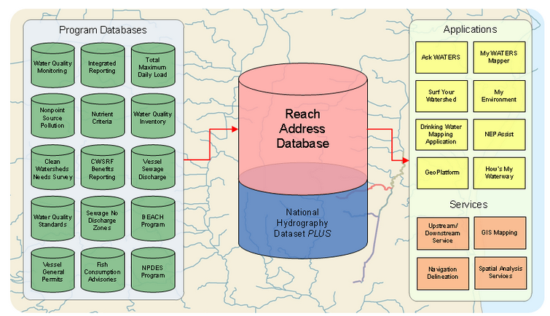
USEPA Waters
Watershed Assessment, Tracking & Environmental Results System
Links databases to address water quality information concerns
Databases includes NHDPlus, National Elevation Dataset (NED), and the Watershed Boundary Dataset (WBD)
http://water.epa.gov/scitech/datait/tools/waters/index.cfm

Slide 10
USFS NRIS Water Module
Database and set of applications for managing acquatic resource information
NHD provides the data model for hydrography
http://www.fs.fed.us/nrm/index.shtml
Notes:
The NHD serves as the source for geographic features for the USGS GIS data dictionary.

Slide 11
NHDPlus
Geospatial, hydrologic framework dataset
Uses value-added attributes (VAA) for network navigation
Integrates NHD with NED and WBD
Uses medium resolution NHD
Includes elevation-derived catchments
Many water quality databases linked to NHDPlus
Stream gaging stations
Water quality monitoring sites
Impaired waters
http://www.horizon-systems.com/nhdplus/

Slide 12
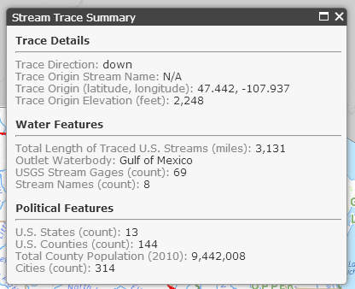
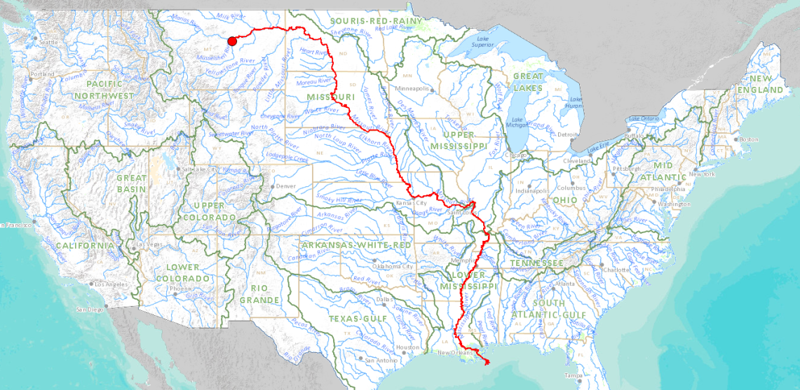
Streamer
Utilizes NHDPlus and medium resolution NHD
Easy user interface to map network tracing and generate report for each trace
Generalized to one million-scale
http://nationalatlas.gov/streamer/Streamer/streamer.html

Slide 13
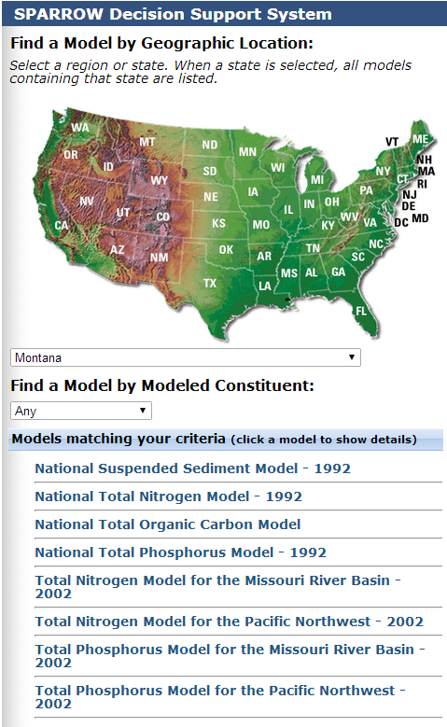
SPARROW – Spatially Referenced Regressions on Watershed attributes
Establishes links between water quality and constituent sources
Tracks transport of constituents
Assesses natural processes affecting constituents while being transported
Predicts changes in water quality
http://water.usgs.gov/nawqa/sparrow/
Notes:
SPARROW relies on digital hydrologic network derived from the NHD and River Reach Files (RF1) to perform modeling.

Slide 14
Summary
NHD is used in a variety of applications
Multiple state and federal agencies utilize NHD in their applications
Examples of research areas and analysis utilizing the NHD
Water quality
Fish passage
Network tracing
Resource management

