Slide 1
Montana Digital Atlas
Objective: Demonstrate tools and data layers found within the Digital Atlas

Slide 2
Navigate to the Digital Atlas, Featured Applications:
MSL home page: http://msl.mt.gov
Left Click on Geographic Information (under Research Resources)
Left Click on Digital Atlas (under Featured Applications)

Slide 3
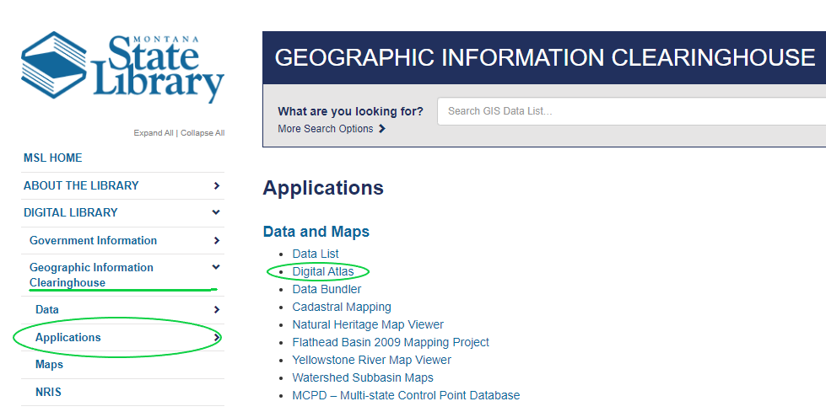
Other ways to Navigate to the Digital Atlas
Navigate browser to:
http://msl.mt.gov/GIS/Atlas
Or from the MSL website:

Slide 4
Getting Started
Open the Digital Atlas:
Help is available!
Click on the “Help Page” link on the Splash Screen
Close the Splash Screen to start using the Digital Atlas

Slide 5
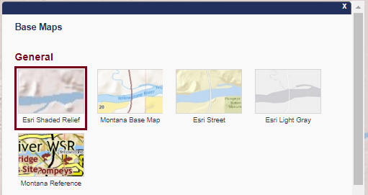
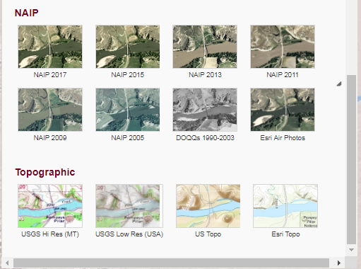
Base Maps
Click on the button.
Above the map
To close, click the “X”

Slide 6
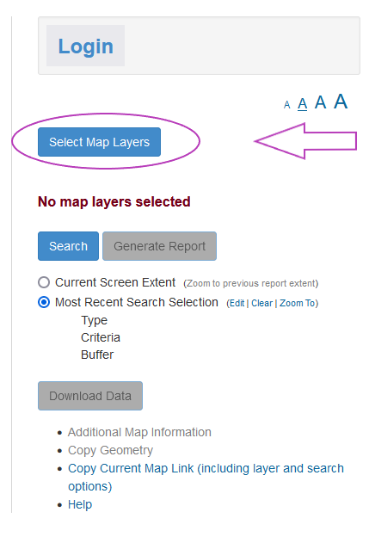
Map Layers
Click on the button:
To the right of the map
Managing Layers:
Click on button to open a new windows with list of available map layers to add to your map.
Scroll through list to navigate through the list.
Note: Some layers have a minimum scale listed. These layers will not draw on the map until you zoom in below this scale.

Slide 7
Map Layers Layer selection Example
Example:
Select the Administrative Boundaries and Schools group
Select the Named Lakes in the Water, Streams and Lakes group
Click on the “Additional Map Information” link and review new window that opens. Close the window.
Click on the “x”

Slide 8
Navigating the Map
Zooming—Plus and minus map buttons (top-left)
Zoom to area—Shift + drag mouse
Zoom in—Double click location (To improve performance in Internet Explorer, adjust your mouse double-click settings)
Zoom in and re-center—Shift + double click location (This may not work in Mozilla Firefox Browser)
Re-center—Shift + click location
Pan—Use keyboard arrow keys or drag mouse (Mouse must be over map for keyboard navigation to work)
Zoom out—Shift + Ctrl + drag mouse

Slide 9
Navigating the Map Example
Example:
Zoom to an area by holding down the shift key and then drag the mouse within the map to draw a square.
Click the “hom button to get back to the default extent:
Tip: The home is underneath the “+ and –” map buttons:

Slide 10
View Coordinates, Data Attributes, and Additional Info
Example:
“Single Click” on map to define a point location
New tabbed window will open
Displays coordinates, location identifier and attributes for the approximate location.
New tab will open for each selected map layer.
Helpful to widen the box to show all fields
Next to the layer tab, a number will show. If it is “0”, that indicates that layer had nothing to select on your mouse click.

Slide 11
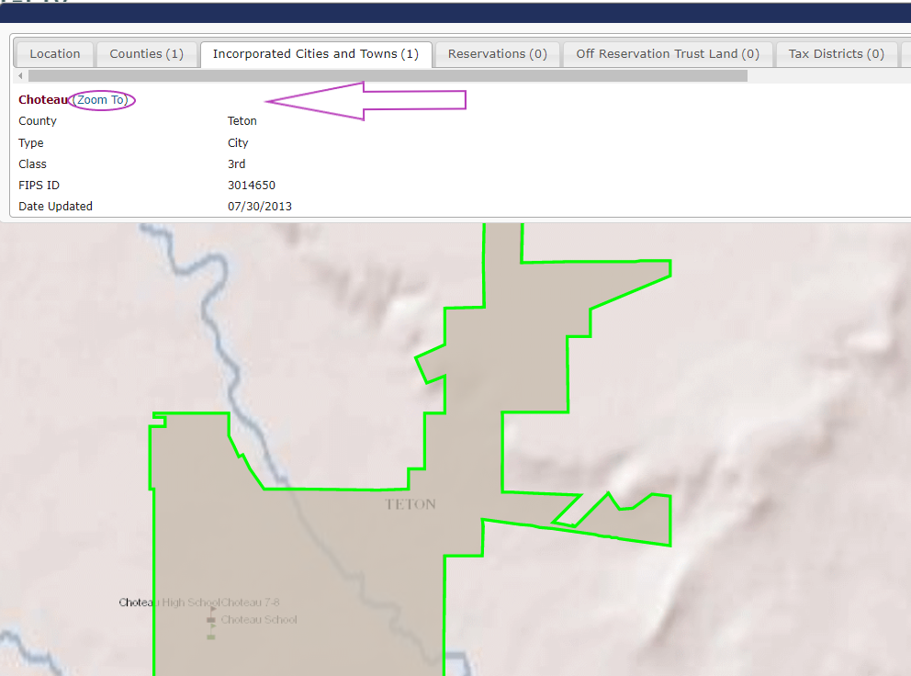
View Coordinates, Data Attributes, and Additional Info
Location tab:
It provides various map coordinates, watershed names, USGS quad names, etc. for the location in the map that was clicked.
Note: Each feature in a layer’s tab has a “Zoom To” link that will zoom the map to that feature and highlight it in green.

Slide 12
Search Example
Search:
Click the “Search” Button:
View the various search options listed including Township/Range/Section, Lakes and Streams, Coordinates, and Addresses.
Click on the Watershed – 4th Code option under Search Type
Choose a Watershed from the dropdown list that displays
Optionally add a buffer.
Click the button:
Once a search is executed, the map zooms to the location. Click “x” to dismiss the Search Window.

Slide 13
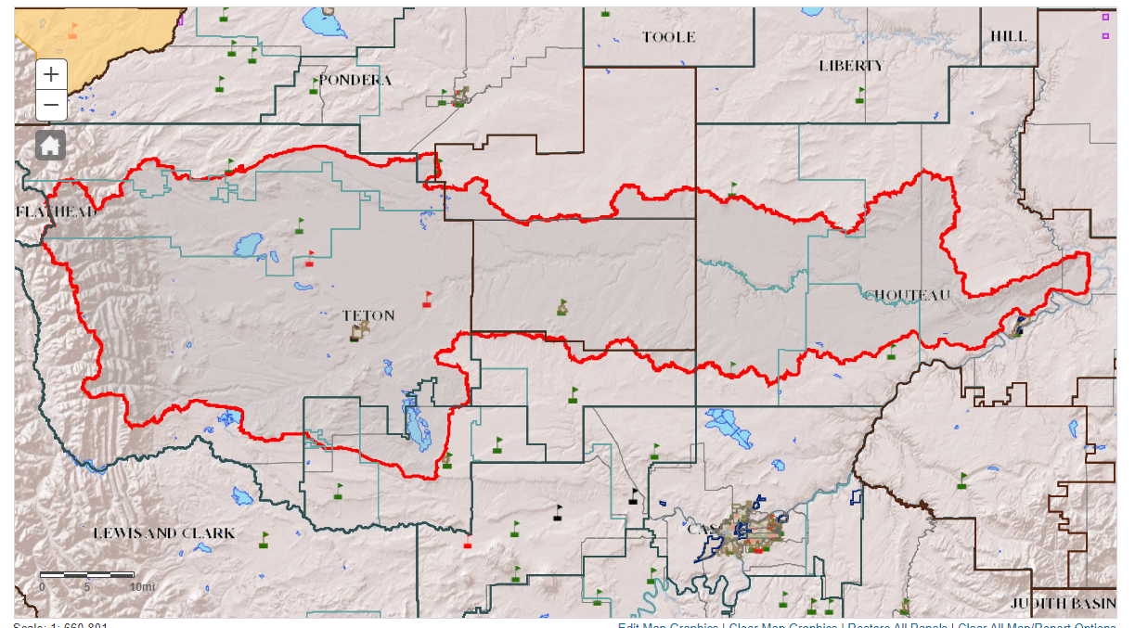
Search Example Results
Search Area:
Area searched will zoom to red polygon:
Click “x” to dismiss the Search Window.

Slide 14
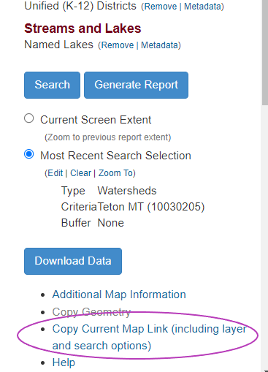
Saving/Bookmarking a Map
Saving/Bookmarking a Map:
Click the Copy Current Map Link to save your map configuration via a Digital Atlas URL:
Link is located on Right side of screen, under “Download Data” button:

Slide 15
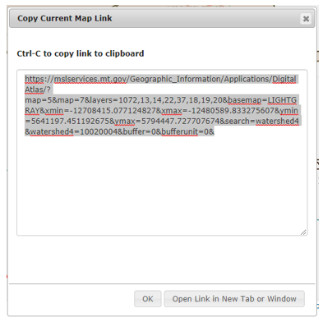
Saving/Bookmarking a Map
Saving/Bookmarking a Map:
A Box with a new map link will appear:
Type Ctrl-C to copy the URL for saving or sharing with others.
Click the Open Link button to open the configured map in a new browser tab.

Slide 16
Generating Reports
Generating Reports:
Click the “Generate Report” button:
A panel is created for EACH selectable layer, including a Summary panel
Note: The reports generate for visible or not visible at current map scale layers.
You may see busy icons next to each layer while the reports are being created in one or more panels

Slide 17
Generating Reports, Panels
Report Panels:
Individual layer panel(s)
Displays the contents of the layer’s attribute table.
Wide attribute tables can be viewed entirely using the horizontal scroll bar under the table.
Note: If the report must access a thousand records or more, a pop-up warning displays for each layer’s report requiring a user response for each warning (continue, cancel, etc.).
Consider reducing number of layers in the map or find a more local scale.
Continuing may cause browser lock.

Slide 18
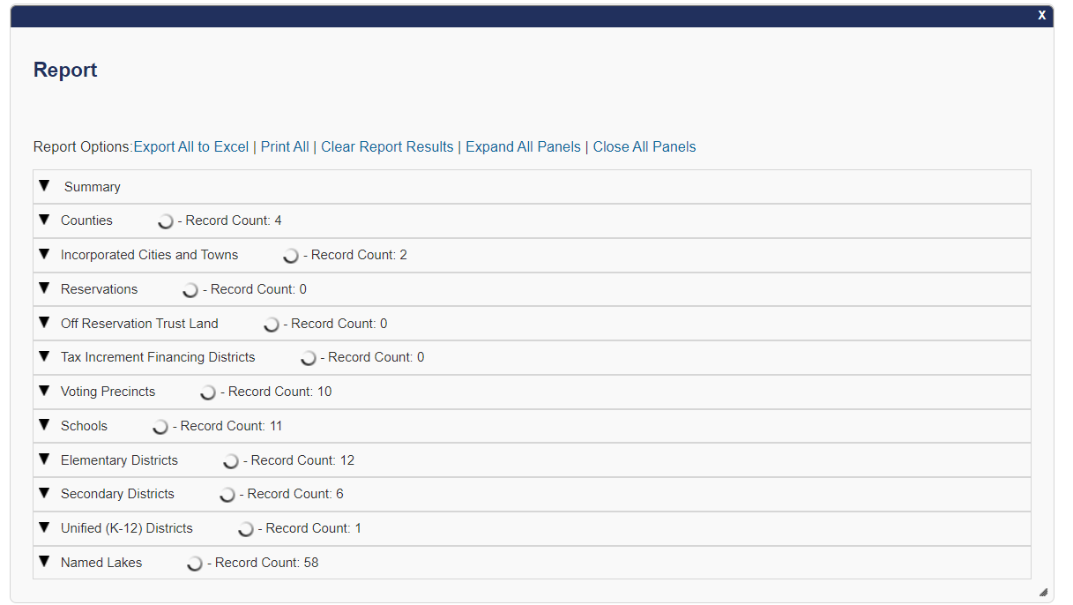
View Report Contents:
Notice the Report Options in the Report Window on the top line.

Slide 19
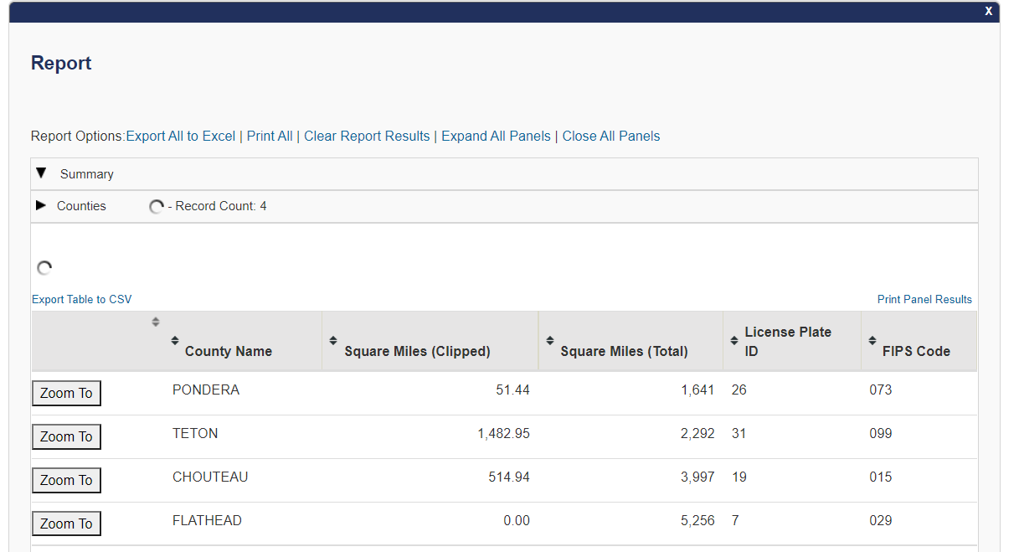
Expanding a panel:
The data layer tables may be sorted on any column
You can print or export individual panels

Slide 20
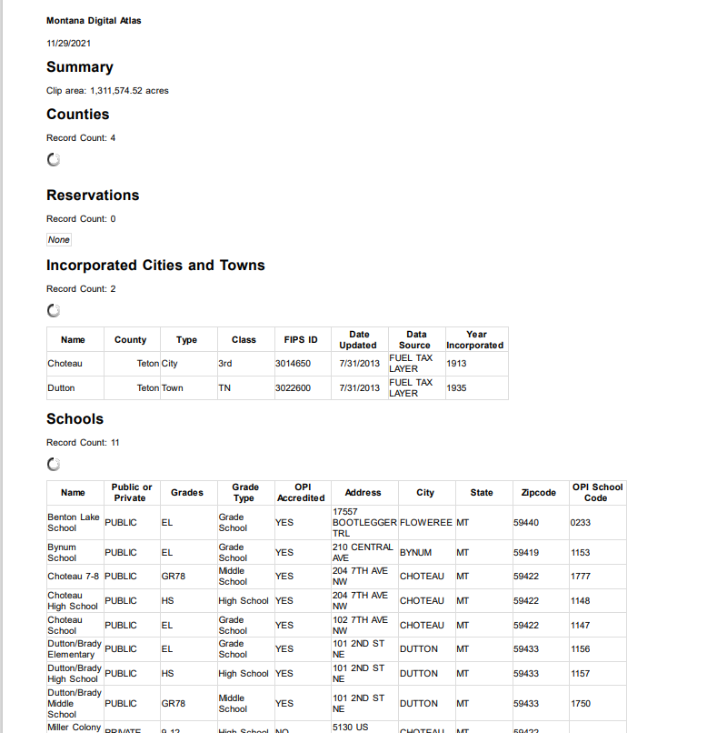
Generating Reports, Printing
Report Printing:
Select the Print All option.
A new browser window will open listing each layer and attributes.
You can choose to save as a pdf or print it.

Slide 21
Generating Reports, Calculating Acres
Calculating acres from Reports, example:
How to calculate the acres of public land by ownership type :
Click Select Map Layer button to select ONLY the Public Land from the Cadastral Group.
Tip: Clear All Map Layers, first!
Close the Select Layers windows with the “x”.
Click button.
In the Report Window click on the “Summary Tab” to see the number of acres by each ownership

Slide 22
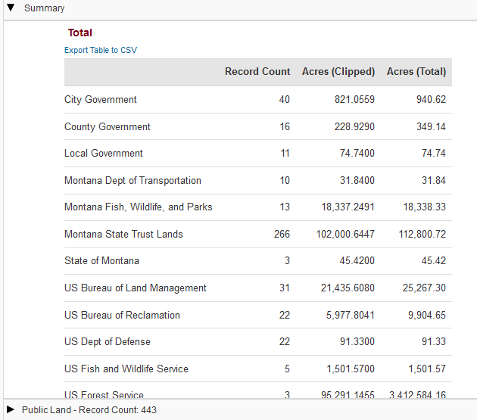
Generating Reports, Calculating Acres: Result
Calculating acres from Reports, result:

Slide 23
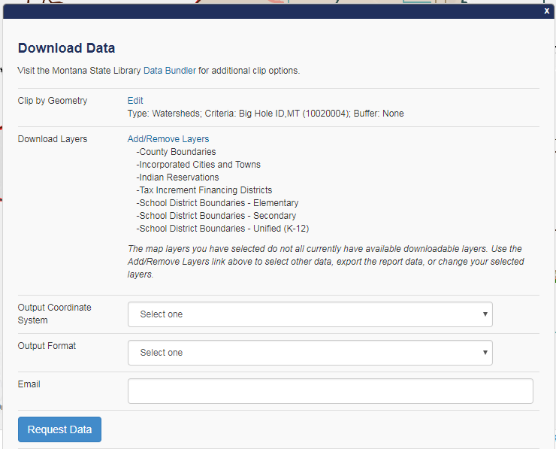
Downloading Data:
Downloading Data:
Click the xxxxxxx button.
The “Download Data” window displays:

Slide 24
Downloading Data, Details:
Downloading Data, details:
You can obtain data clipped to your area of interest using the Digital Atlas.
The Clip by Geometry section of the window shows the extent used to clip the data for download.
The Download Layers section shows a list of the downloadable layers in the map. Not all layers are downloadable, so this section may be empty.
Select the Add/Remove Layers link to include additional layers to your request.
Select a coordinate system and output format using the pull-down menus.
Provide an email address that will receive a download data link once the request is processed.

Slide 25
Questions?
geoinfo@mt.gov
(406) 444-5354

